Slide 1
Prediction of mobile application rating
Semester project `
By – muhammad sahab tariq

Slide 2
Research Focus: Prediction of mobile application rating. Dataset contains almost 10,000 rows having 8 attributes. Source of dataset is Kaggle.
Problem:
Supervised Learning
Regression Problem
Removed Noise from Data:
Make SIZE attribute generic.
Remove + , ` sign from INSTALL column.
Change Last update column.
Remove noise from other columns.

Slide 3
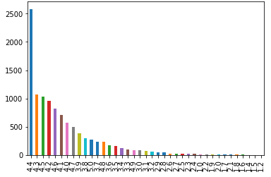
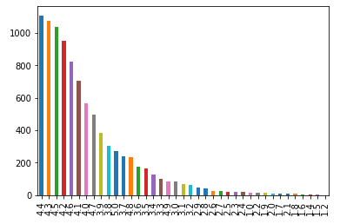
Dealing with NaN values:
There are almost 1500+ NaN values in Rating column.
1st Strategy:
Remove NaN values with mode of rating.
Results in unbalanced data.
2nd Strategy:
Remove NaN values.

Slide 4
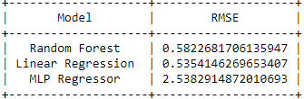
Training & Testing
Trained Random Forest Regressor, Linear Regression and MLP Regressor.
Calculate Root Mean Square Error

Slide 5
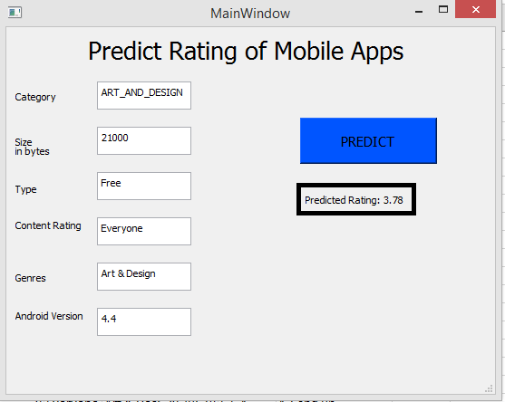
Application Phase
Train All data on Linear Regression for application phase.
Final Product:

